Slide 1
FHIR Roadmap
R5 and beyond
Lloyd McKenzie

Slide 2

Who am I?
Name: Lloyd McKenzie
Company: Gevity
Background:
One of FHIR’s 3 initial editors
Co-chair FHIR Management Group and FHIR-Infrastructure
HL7 Fellow
Heavily involved in HL7 and healthcare exchange for last 19 years (v2, v3, CDA, etc.)
lmckenzie@gevityinc.com

Slide 3
FHIR Timeline (so far)
First Draft
1st
STU
2nd
STU
3rd
STU
R4
R5?
2011
2012
2013
2014
2015
2016
2017
2018
2019
2020
2021
Notes:
R4 was a major milestone
First normative content
Patient, Observation, many infrastructure resources and pages
Much still remains as “Standard for Trial Use”, or even Draft
Timeline for R5 will be confirmed at the WGM next month, though it’ll be somewhat dependent on ballot

Slide 4
R5 plans
Key clinical resources normative
AllergyIntolerance
MedicationRequest, MedicationStatement, MedicationDispense
Condition
ServiceRequest
Encounter
Practitioner, PractitionerRole
A few others

Slide 5
Maturity levels
Intended to indicate level of stability
FMM1 – Resource is “done”, no build warnings
FMM2 – Tested at approved Connectathon
FMM3 – Passes QA, has passed ballot
FMM4* – Tested across scope, published, prototype implementation
FMM5* – 5 distinct production implementations, 2+ countries
Non-compatible changes at level 4 and 5 will face increased hurdles

Slide 6
Future for HL7 – Resource Maturity
Notes:
From HL7’s perspective, some things are pretty clear.
The ‘common’ clinical resources – those typically used by EMRs and similar systems– have largely been defined and are increasingly stable. However, we’re going to continue to define new resources for newer interoperability areas and heavily regulated areas where FHIR adoption has been slower. For example, the drug product approval resources introduced as draft in R4, or the public health and evidence-based medicine we’re looking at now.
These graphs are estimates, but we’ve got a decent sense of our expected scope and trajectory. Over the next 10 years or so, FHIR will continue to move more resources to normative
The most common of these – AllergyIntolerance, Procedure, MedicationRequest, etc. should be locked down around the end of 2020 or early 2021
As a result of this increasing stability, the focus and energy we put into the FHIR core specification is already starting to decline – and that will continue as more and more of the core spec becomes stable.
Where is that energy going to go?

Slide 7


What else will HL7 be focusing on?
Notes:
Some portion will go into developing and supporting new technologies that sit on top of FHIR – things like SMART, CDS Hooks and newer technologies like Bulk Data and FHIRCast,
In many ways, the technologies built on top of FIHR are even more exciting than the FHIR core specification. These technologies fundamentally change healthcare IT architectures and introduce new business models
We expect to continue to see new layers being designed that sit on top of FHIR, though it’s hard to predict exactly what they’ll do

Slide 8

What else will HL7 be focusing on?
Notes:
Some energy will continue to go into improved support for implementers – testing tools, open source solutions, visual navigation tools, guidance for converting from other standards, language translations, etc.

Slide 9
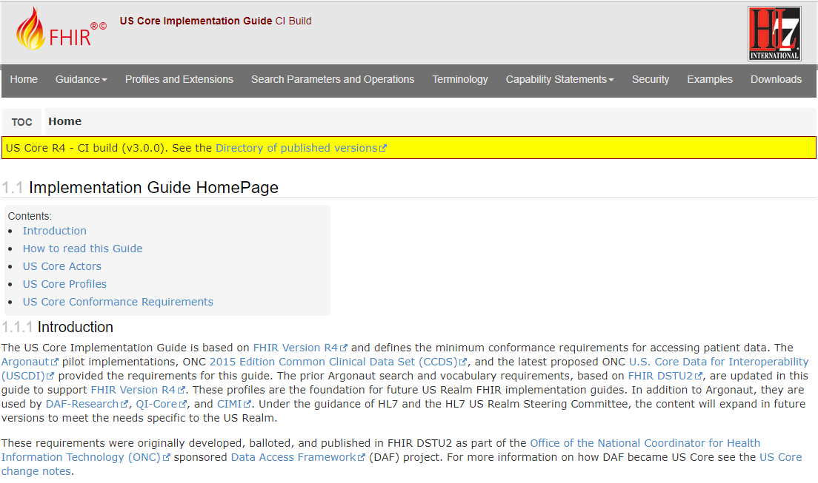
What else will HL7 be focusing on?
Notes:
However, most of HL7’s energy – and the community’s energy – will go into the creation of implementation guides
The base FHIR specification gives a framework for interoperability. Implementation guides apply that framework to solve real-world issues – for example, genomics, registries, financial management, etc.
At present, HL7 is balloting 20-30 FHIR IGs/year. The world at large is building many times that. That rate is going to double or triple over the next few of years, driven by the increased stability of the specification, greater implementation of FHIR in general and improved tooling for IG creation

Slide 10
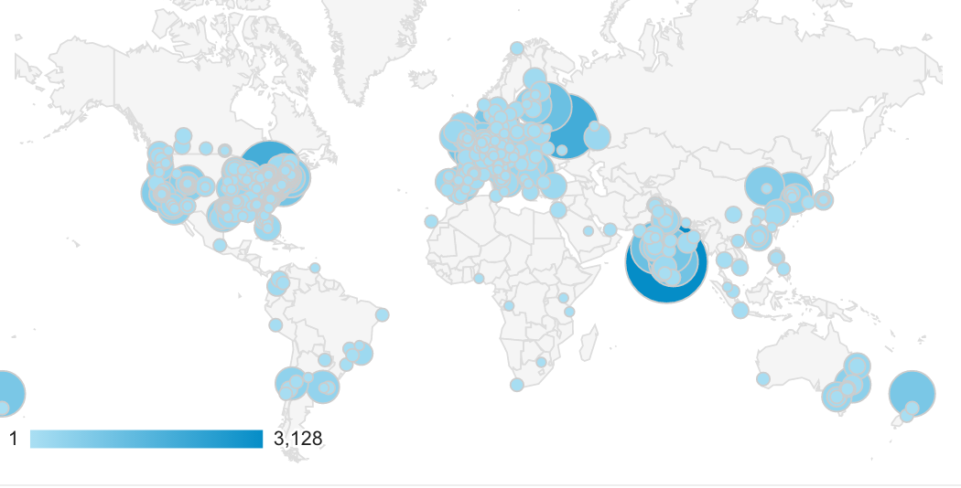


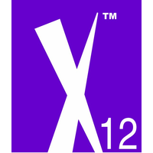



The FHIR Community
Notes:
One of the most important elements of FHIR’s success is the community:
The people who build the tools, test environments, reference implementations and other infrastructure implementers rely on
The people who ask questions and those who provide answers and nudge implementations towards greater consistency
The people who implement FHIR and report where the problems are so that other implementers can avoid them and future versions of the specification can fix them
The FHIR community has grown into the thousands and it’s continuing to get larger
That community isn’t just HL7. IHE is going full blast developing FHIR implementation guides. X12, NCPDP and others have also coordinated around the development of FHIR content and implementation guides. (new slide) New groups have also formed, such as Argonaut, Carin Alliance and Davinci
For older SDOs, there’s increased interest – and absolutely a possibility – of those SDOs creating and publishing their own FHIR implementation guides. The base specification and the tooling are freely available – why not leverage the standards communities that already exist to create the specifications implementers want?
The community can also grow beyond “traditional” standards developers. Professional organizations like ASCO (the American Society of Clinical Oncology) can and should create implementation guides that reflect the expertise and needs of their membership
As the community continues to grow, we’re almost certainly going to run into scaling problems. We want to maintain FHIR’s open, practical, implementer-focused nature, but we’re integrating the cultures and practices of a lot of different organizations and countries. That won’t always go smoothly.
To help mitigate some of these issues, HL7 – in conjunction with other SDOs – is developing a FHIR Community Process to encourage a degree of consistency and coordination as the FHIR community continues to expand

Slide 11
Future for implementers
Increased adoption/expectation
Conversion of CDA/V2
Certification?
Increased sophistication
Read only
Write capability
Full business integration
Notes:
Obviously FHIR will continue to penetrate new spaces – driven by the market as well as regulation. Those who have held back waiting to see what was going to happen will start rolling out FHIR solutions
Those with legacy solutions built on CDA and v2 interfaces will leverage the translation work that’s happening now to expose parallel FHIR interfaces
though they may find that getting the full benefit of FHIR will require re-architecting, not just data format conversion
As specifications and implementations start to stabilize, there’ll be increased talk about certification, though we’re not yet sure how important that will be – or how it will work.
Those who have implemented FHIR APIs will continue to make their way up the sophistication scale

Slide 12
The standardization pyramid
Business Processes
Codes & Data Organization
Data Structures & APIs
Notes:
Implementers typically start with, read only access – because it requires the least changes to their existing system
From there, they move to write access for objects that are typically only written once (Observations, documents), but with increasing sophistication includes dynamic objects such as encounters and conditions
Finally comes integration into business processes – including ability for external systems to initiate activities and orders and manipulate workflow (such as suspending or cancelling processes)
As implementations move up that maturity scale, there becomes an increased need for standardization
The FHIR core specification standardizes the base data structures & APIs
Above that, useful read access and any sort of write access requires standardizing code values and how data is organized above and beyond the base standard. For example,
How are vaccines coded?
What’s the proper structure for an APGAR or a medication summary?
Integration into order processing and task lists starts to require standardization of business processes
What does it mean to have a patient-centric cross-organizational care-plan – or even a consolidated medication list?
Who is allowed to update a Condition and how are multiple condition records for the same issue rationalized across multiple providers?
The more the standardization, the more the impact on healthcare practitioners themselves – both in terms of what data they’re asked to capture and how they’re asked to interact with systems. To truly realize the benefits of increased data sharing, clinical practices will need to evolve and become more consistent. –That, in turn, is going to take a lot of change management because clinicians aren’t used to enforced consistency around their processes and collaboration. Doing this successfully will require significant leadership from the clinical space and from organizations outside the “IT standards” space.

Slide 13
What we’re trying to achieve
Disrupt: Healthcare standards
Disrupt: Healthcare IT
Disrupt: Healthcare
Notes:
Early in the creation of FHIR, a small group of us at HL7 who were driving this new standard talked about what we wanted to achieve. Grahame identified three steps along the path to where we wanted to go
(new slide)First, we needed to disrupt healthcare standards – we needed to move from a place where the focus was on getting the standard “approved” to prioritizing getting the standard “used” – and not just because a regulator required it. That meant dramatically increasing the importance of both implementers and implementability, as well as real-world testing before locking anything down. We also needed to make standards open and community driven and led That level of disruption has been largely achieved in HL7 and those same changes are making their way, one way or another, into other healthcare standards organizations.
(new slide)The second was to Disrupt Healthcare IT. With the introduction of APIs, together with SMART, CDS Hooks and similar technologies, we’re seeing a re-shaping of the old messaging and document-centric healthcare IT ecosystem. We’re a long way from done, but the momentum is such that it’s now a question of when, not ‘if’ those changes will be rolled out.
(new slide)The final step was to disrupt Healthcare itself – That’s what FHIR – and the FHIR community – is truly about. It means getting better decisions made, providing continuity of care across providers and organizations, empowering patients to make decisions, realizing greater efficiencies and, most importantly, actually helping people live longer, healthier lives throughout the world. We’re seeing signs of the impact FHIR can have in this space already, but for this level of disruption, we’ve only just started. There’s a lot more change to come and a lot more good to do
It’s meetings like this where we move the disruption ball forward.

Slide 14

Questions / discussion?
lmckenzie@gevityinc.com
(or PM me on http://chat.fhir.org)

